Slide 1


Delaware
WELCOME TO BREATHRU DELAWARE

Slide 2
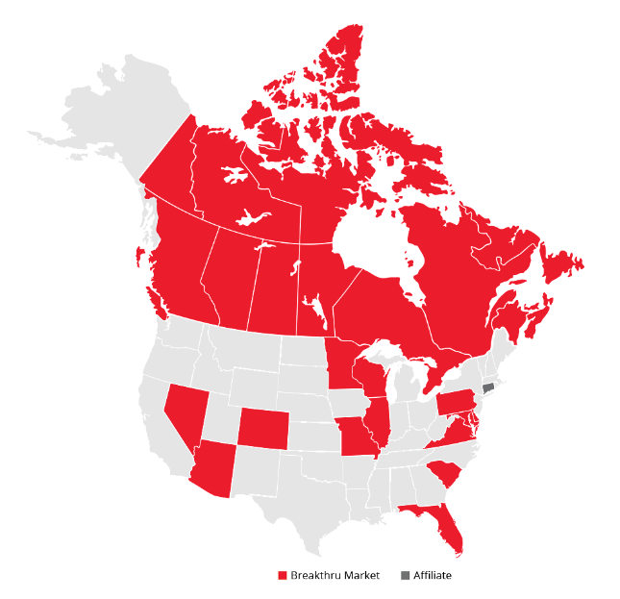

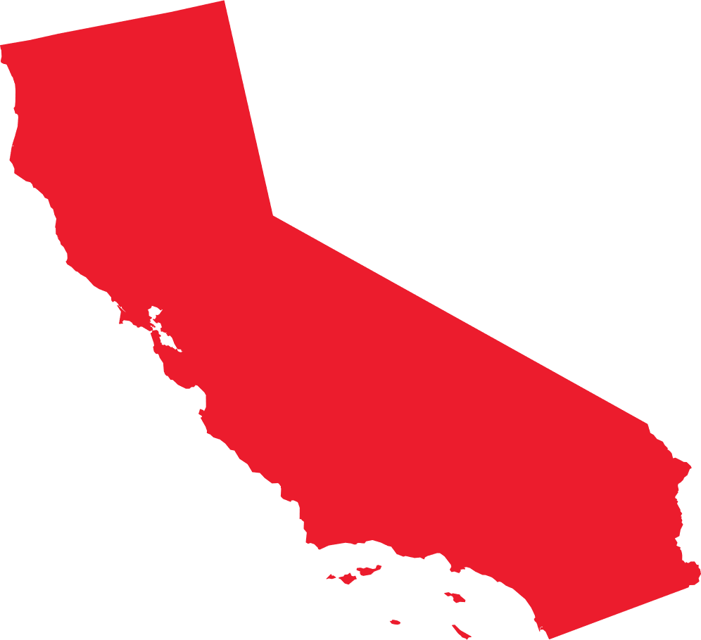
Two Families with a Rich Heritage & Strong Next Generation Leadership
1934
1944
1945
1997
McKesson
Wine & Spirits
Established
Charles
Merinoff, Sr. founds
Blue Crest Wine & Spirits Corp
Arthur Wirtz
enters the wholesale bev business in
IL & WI
McKesson & Merinoff holdings merge to form Charmer Sunbelt Group
2010
2015
2016
2022
2022
2023
Wirtz corp aligns their beverage business to form Wirtz Beverage Group
Wirtz Beverage
establishes an International footprint with Canada
Wirtz Bev & Charmer Sunbelt
merge to form
Breakthru Beverage Group
Breakthru Beverage Group
acquires J.J. Taylor, expanding its beer footprint in MN
Breakthru Beverage Group
acquires Major Brands, expanding its footprint into MO
Breakthru Beverage Group
acquires Wine Warehouse in CA in April

Slide 3
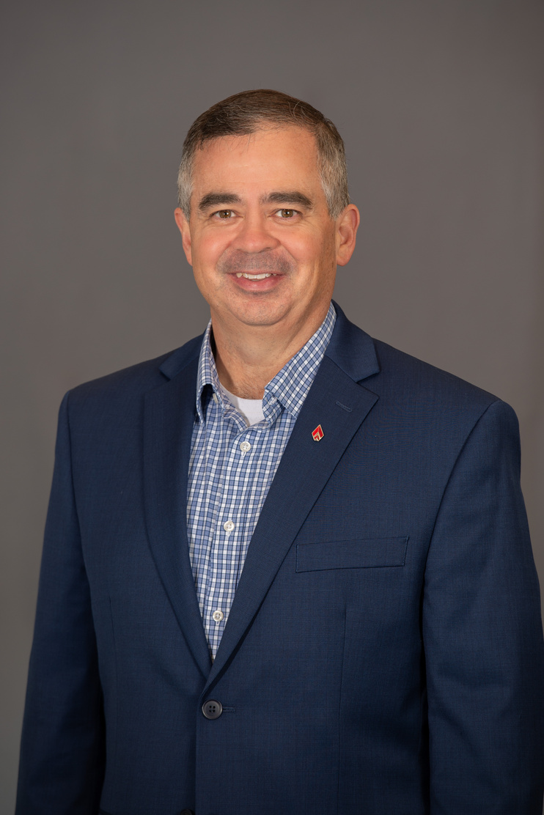
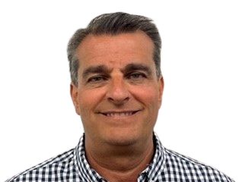
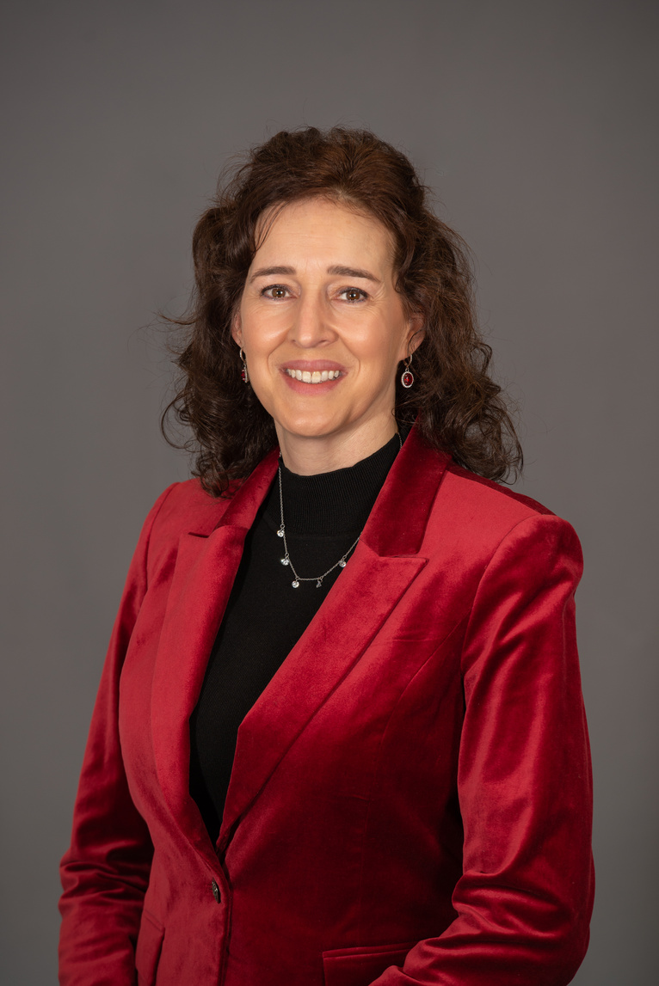
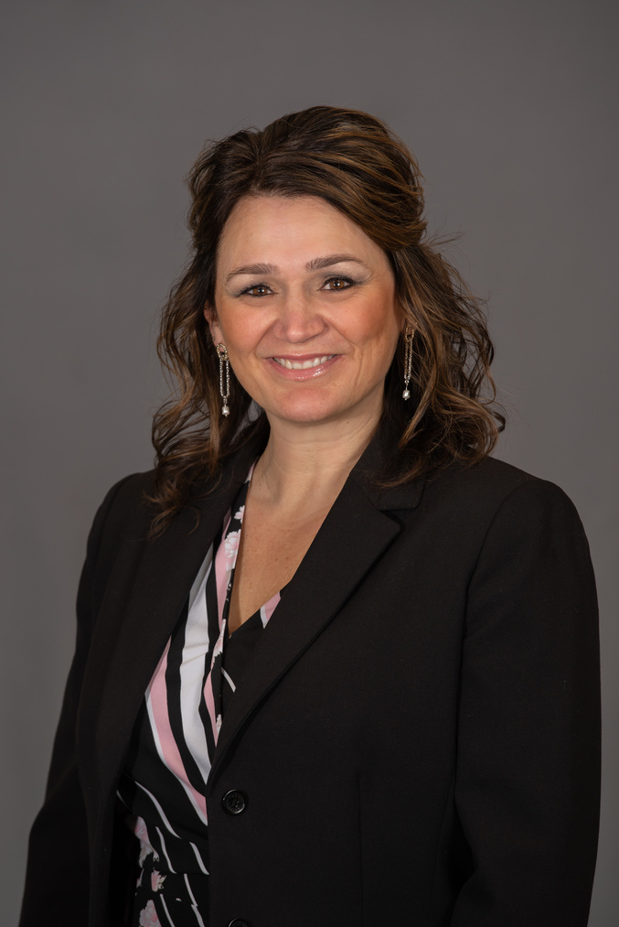
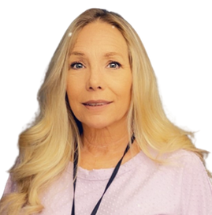
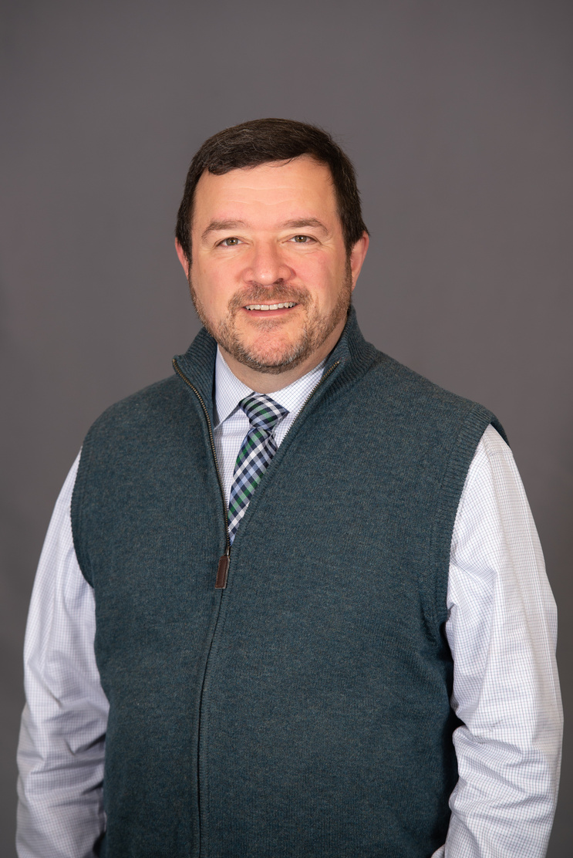
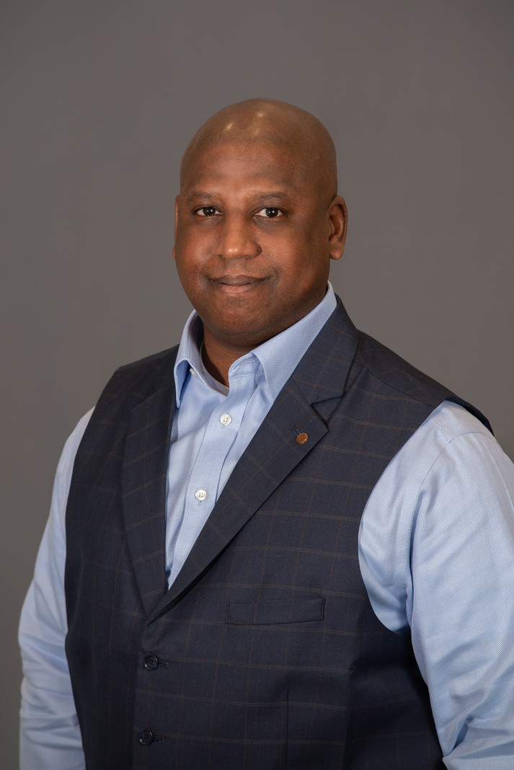
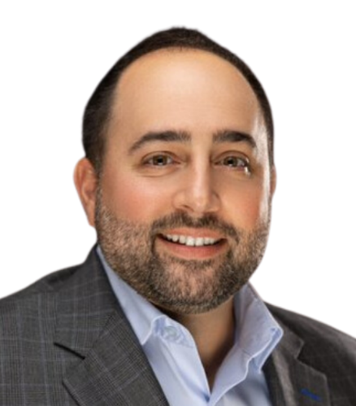
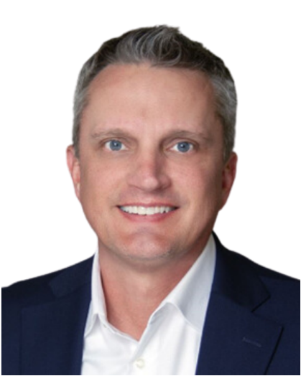

Meet Our Delaware Leadership Team
Tim Daning
Alex Economos
Shannon DeLucia
Nicole Green
Shelley Dickson
Executive Vice
President
Director of
Operations
Director of
Human Resources
Director of
Finance
Executive
Assistant
George Fresolone
Patrick Stancil
Chris Troisi
Joe Powell
OPEN
Trade Developement Director
Revenue Management
Director
VP Sales
VP Sales
Titan Division
United Division

Slide 4
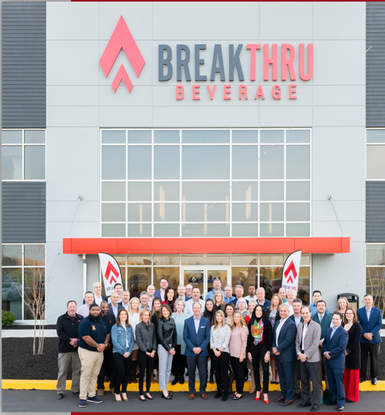
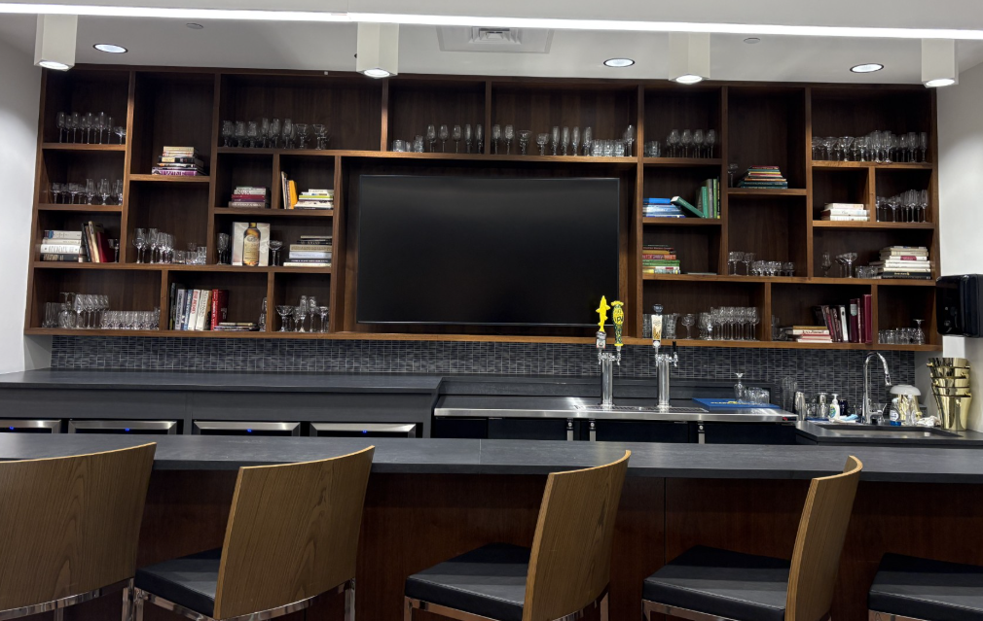
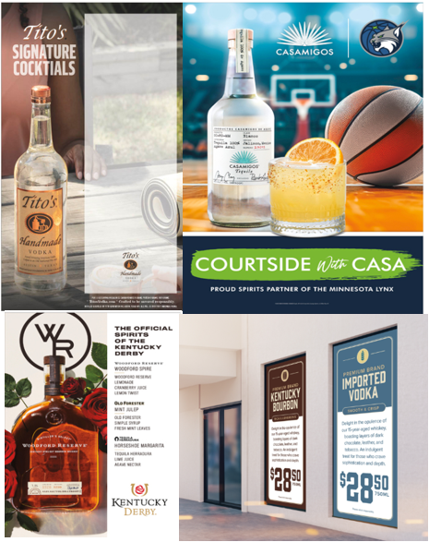
BREAKTHRU BEVERAGE DISTRIBUTOR OF CHOICE
  Breakthru Now Information
    www.Now.Breakthrubev.com
      Place orders 24 hours a day, 7 days a week
      View delivery status
      Enroll in PayNow, fast, secure 24-hour account access
      Complete listing of entire Breakthru Beverage of DE Portfolio
      Create a favorites list & recently purchased items
      Review top trending products
  Breakthru Beverage of DE Important Contact Information
    BBG DE Front Desk 302-844-8900
    Credit Department 302-844-8912
    Tele-Sales Contact 302-204-1930
  Credit Department Information
    New Customers MUST fill out a Breakthru Beverage Credit Application
    Credit Department contact information
      TradeARTeam@Breakthrubev.com
      Credit Team 302-844-8912
  Breakthru Beverage Capabilities
  2022 Opened new office and warehouse facility in Middletown DE
    282K square feet of warehouse space on 30 acres
  Brand Muscle
    Custom signage to drive activation and consumer awareness
  Alchemy Training Room
    Can be utilized for category trainings, drink menu development, one-on-one training or bartending refinements. Our Alchemy program is here to help.
  Trade Education
    3rd Party Samplings
  Draft Beer Service
    Craft Beer Portfolio
    Draft tower Maintenance
  Online Delaware Product Catalog
BBG DE Alchemy Room
Brand Muscle Signage

Slide 5
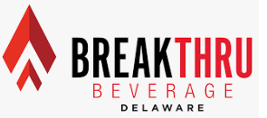
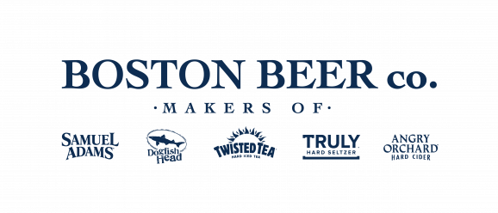
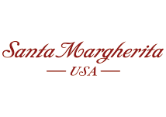
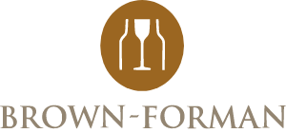


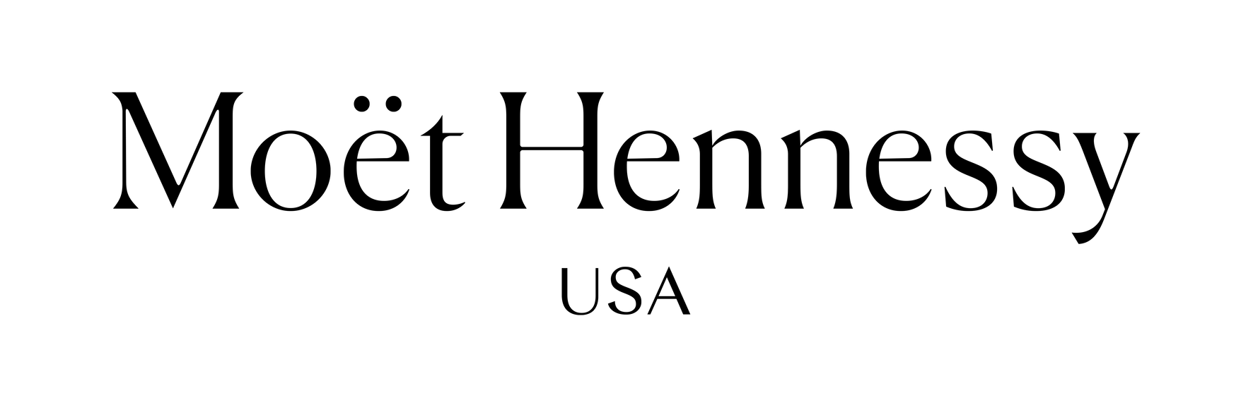



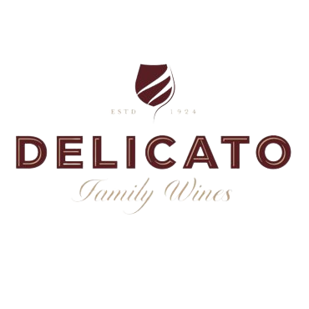
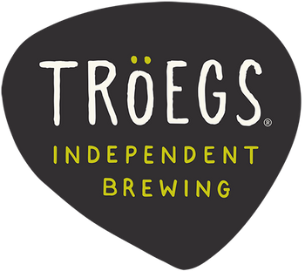
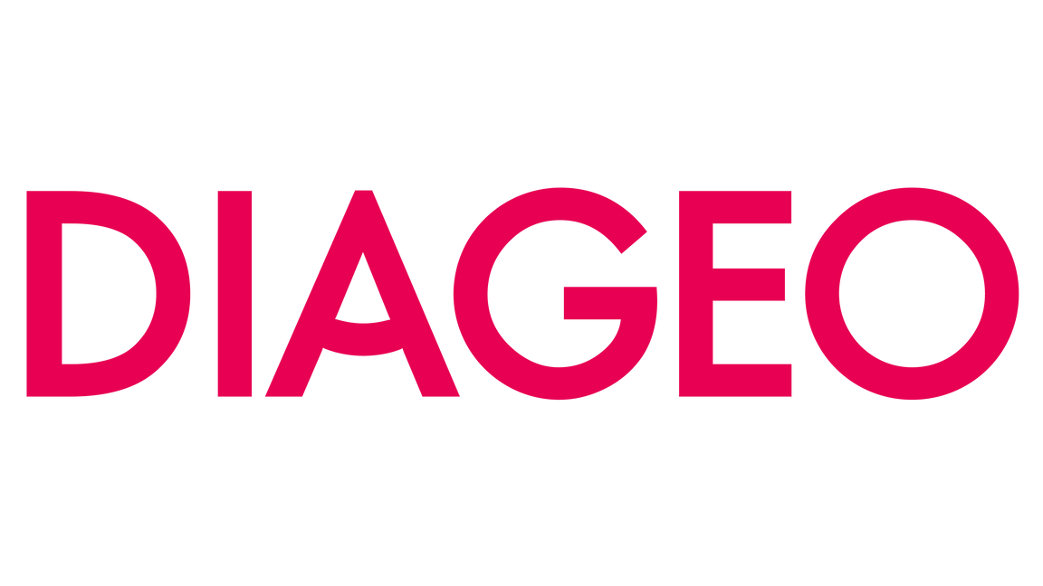
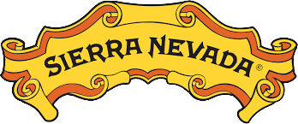



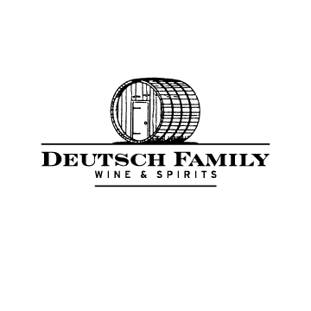


Strategic Partners

